Slide 1
IBM University Engagement Project Submission
“Exploring the Power of Agentic AI with IBM Granite and IBM Bob”

Slide 2
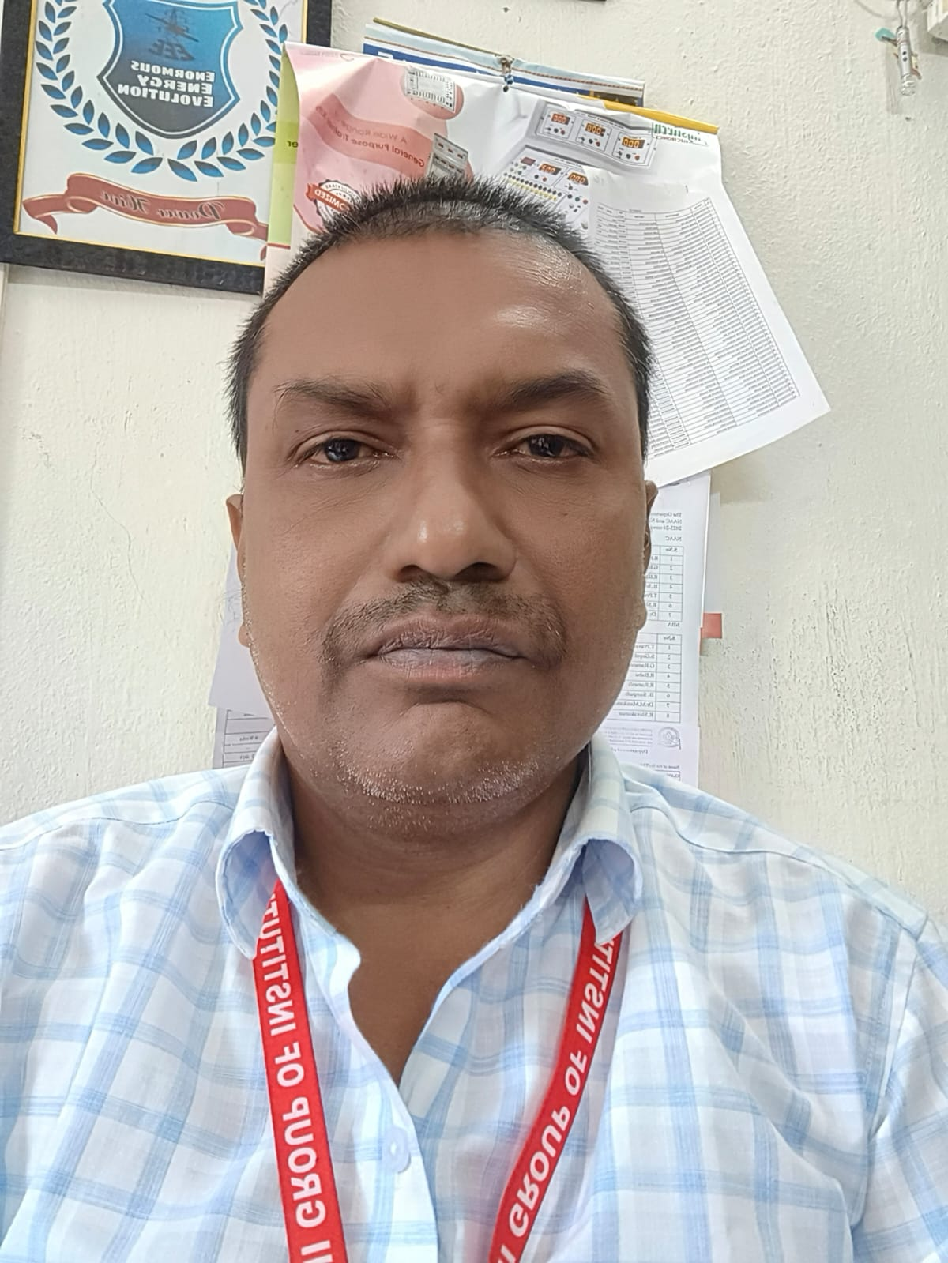
Project Tile – Multi-Agent Smart Agriculture Planning System
Domain of Project – Agriculture
Student Name | Recent Passport Photo | Email ID | Mobile number [WhatsApp]
DR.THOTA PRAVEEN KUMAR |  | praveenkumarthota782@gmail.com | 8179830943
Recommended font style and size: Font Style: Arial Font Size (Heading): 28
Font Size (Content): 20

Slide 3
Problem Statement
The Challenge
Small and marginal farmers often struggle to make timely and informed farming decisions due to changing weather conditions, uncertain market prices, soil variability, pest and disease outbreaks, and limited access to expert agricultural guidance. These challenges lead to lower crop productivity, inefficient resource utilization, higher cultivation costs, and reduced profitability. An AI-powered solution is needed to provide personalized, real-time, and data-driven recommendations that help farmers optimize crop planning, farm management, and market decisions throughout the agricultural lifecycle.
The Objective
Develop AgriSmart AI, an Agentic AI-powered Smart Agriculture Planning System using IBM watsonx.ai Granite Models, IBM BOB (watsonx Orchestrate), and IBM Cloud. The solution employs two collaborating AI agents: a Farm Intelligence Agent that collects and analyzes farm-specific data such as soil health, weather forecasts, crop stage, irrigation availability, pest and disease risks, and relevant government schemes by interacting with external APIs and agricultural knowledge bases; and a Decision & Advisory Agent that uses these insights to autonomously generate an optimized crop management plan, including crop selection, irrigation schedules, fertilizer recommendations, pest management strategies, expected yield and profitability, and market timing recommendations. The agents continuously communicate, dynamically update recommendations as environmental and market conditions change, provide transparent explanations for every recommendation, and proactively alert farmers about critical farming actions through an interactive dashboard, enabling sustainable, data-driven, and profitable agriculture

Slide 4
Proposed Solution: Multi-Agent Smart Agriculture Planning System
Proposed Solution
Develop AgriSmart AI, an Agentic AI-powered Smart Agriculture Planning System that helps farmers make informed decisions throughout the crop lifecycle using IBM watsonx.ai Granite Models, IBM BOB (watsonx Orchestrate), and IBM Cloud. The platform leverages two collaborating AI agents that continuously analyze farm conditions, generate personalized recommendations, and adapt to changing environmental and market conditions.
The Farm Intelligence Agent gathers and processes real-time farm-specific data from multiple sources, including soil health reports, weather forecasts, irrigation availability, crop growth stage, pest and disease alerts, satellite imagery, and agricultural knowledge bases. It continuously monitors these factors to build a comprehensive understanding of the farm's current conditions and identifies potential risks or opportunities.
The Decision & Advisory Agent uses the insights generated by the Farm Intelligence Agent to create an optimized crop management plan tailored to each farmer. It recommends suitable crops, irrigation schedules, fertilizer application plans, pest and disease management strategies, harvesting timelines, expected yield and profitability, relevant government schemes, and the optimal market timing for selling produce. Every recommendation is accompanied by a clear explanation, enabling farmers to understand the reasoning behind each decision and build trust in the system.
The two AI agents communicate seamlessly through IBM BOB (watsonx Orchestrate), enabling continuous collaboration and dynamic updates whenever weather forecasts, soil conditions, pest risks, or market prices change. The system proactively notifies farmers about critical actions such as irrigation schedules, fertilizer application, pest outbreaks, extreme weather events, and favorable market opportunities.
An interactive dashboard presents real-time farm insights, AI-generated recommendations, weather forecasts, crop health status, profitability estimates, government scheme information, and alerts in a simple and intuitive format. By combining real-time data, autonomous AI agents, and explainable recommendations, AgriSmart AI empowers farmers to make data-driven decisions, improve productivity, reduce input costs, enhance sustainability, and maximize profitability throughout the agricultural lifecycle

Slide 5
Technology Used
IBM Bob platform -For designing and orchestrating multi-agent workflows visually
IBM Grainte model - for eg – ibm-granite-3-2-8b – For natural language understanding, reasoning, and personalization
IBM Cloud – It provides the infrastructure to build, deploy, and scale the Nutrition Agent efficiently. IBM Cloud enables a reliable, secure, and scalable environment for deploying the Nutrition Agent.
IBM Watson studio,watson runtime,cloud object storsge – For creating new project on IBM cloud
Prompt engineering- for defining the goal of the agent

Slide 6
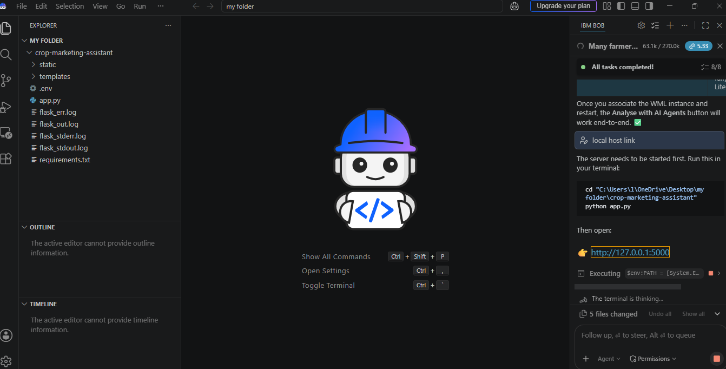
Required Files created using IBM bob -
App.py
Requirements.txt
Style.css
.env
Index.html

Slide 7
IBM Bob Screenshots:

Slide 8
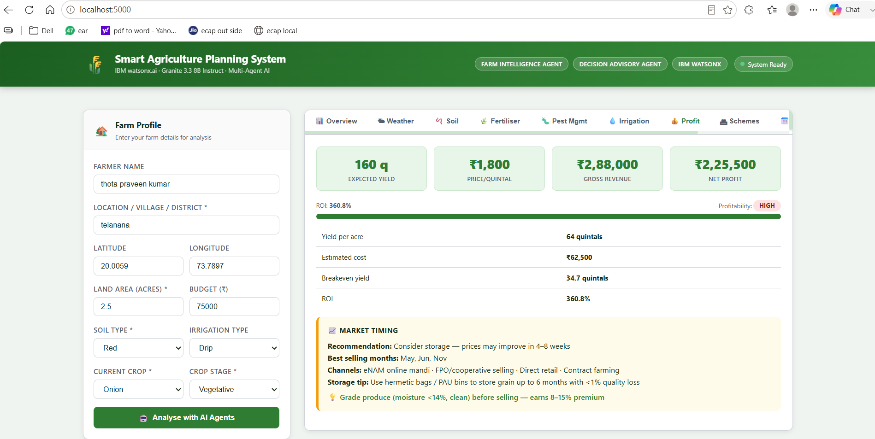
User interface for Multi-Agent Smart Agriculture Planning System

Slide 9
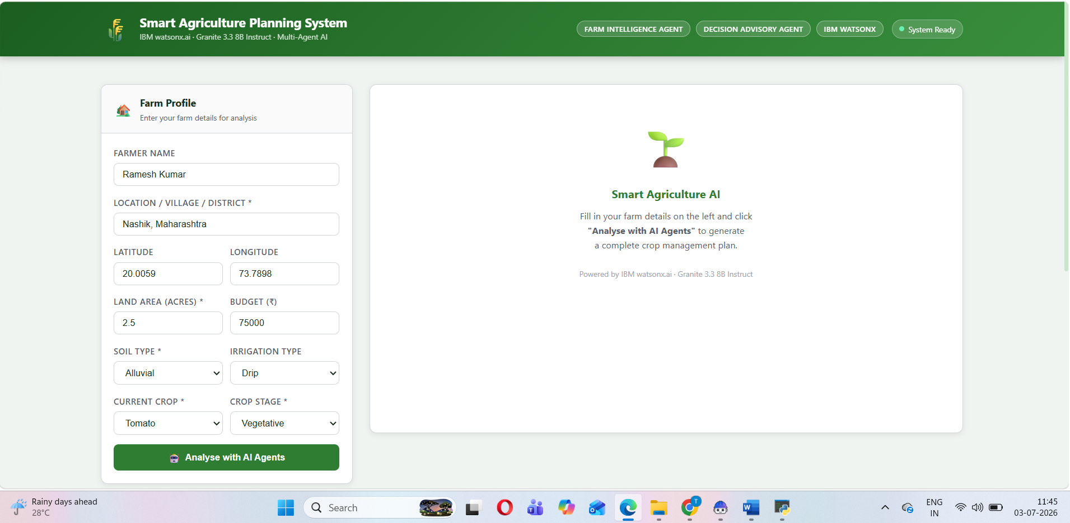
User prompt for Multi-Agent Smart Agriculture Planning System

Slide 10
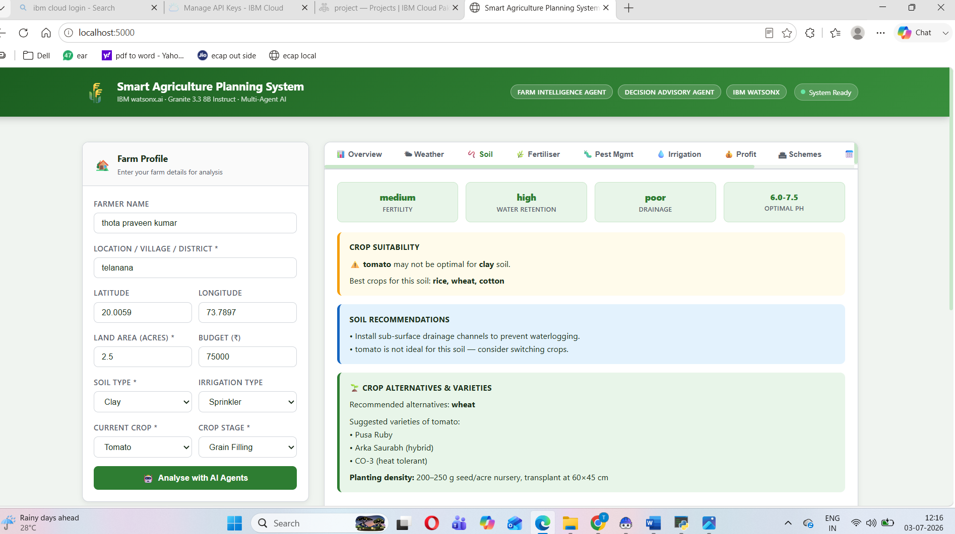
Response

Slide 11
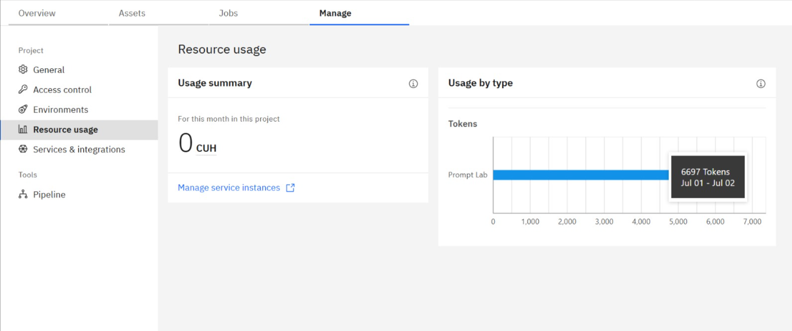
Token Usage
·
·
·

Slide 12
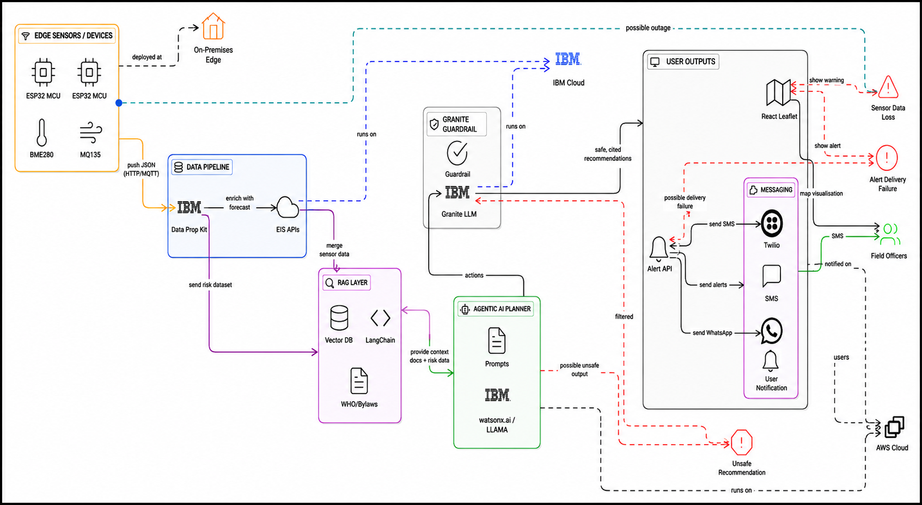
Architecture blueprint
·
·
·

Slide 13
Novelty and Uniqueness
The proposed AgriMarket AI combines Agentic AI, RAG, and real-time market intelligence to deliver smart, personalized crop marketing recommendations.
Multi-Agent Intelligence – Two AI agents collaborate to collect market data and generate optimal selling strategies.
RAG-Powered Insights – Retrieves real-time crop prices, demand trends, MSP, and government schemes from trusted sources.
Personalized Recommendations – Suggests the best market, selling time, and pricing strategy based on crop, location, and transportation costs.
Explainable AI – Provides transparent reasoning behind every recommendation to build farmer trust.
Real-Time Decision Support – Continuously updates recommendations as market conditions change.
Interactive Dashboard – Displays market comparisons, price trends, profit estimates, and AI insights through intuitive visualizations.
Enterprise-Ready Solution – Built on IBM Bob, IBM watsonx.ai, IBM Cloud, and Granite Models for scalability, reliability, and AI governance.
AgriMarket AI is more than a price lookup tool—it is an intelligent AI-powered crop marketing advisor that enables farmers to maximize profits through data-driven decisions.

Slide 14
Git Hub Link
https://github.com/praveenkumarthota782-creator/Multi-Agent-Smart-Agriculture-Planning-System.git
1. Generative AI in Action Credly Certificate
2. IBM BOB Certificate
3. PPT
4. Problem Statement
·
·
·

Slide 15
Future Scope
AgriSmart AI can be expanded beyond crop planning into a comprehensive digital farming ecosystem. Potential future enhancements include:
1. IoT-Based Smart Farming
Integrate IoT sensors to collect real-time data on soil moisture, temperature, humidity, pH, and nutrient levels, enabling automated and highly accurate farming recommendations.
2. AI-Powered Crop Disease Detection
Incorporate computer vision models that analyze images captured from smartphones or drones to detect crop diseases, pest infestations, and nutrient deficiencies at an early stage.
3. Satellite and Drone Monitoring
Leverage satellite imagery and drone-based remote sensing to monitor crop health, estimate biomass, detect water stress, and identify affected areas across large farms.
4. Precision Agriculture
Provide field-specific recommendations by dividing farms into management zones, optimizing irrigation, fertilizer application, and pesticide usage to reduce costs and environmental impact.
5. Predictive Yield and Profit Analytics
Enhance AI models to forecast crop yield, production costs, market demand, and profitability using historical data, weather patterns, and market trends.
6. Smart Irrigation Automation
Integrate with automated irrigation systems to control water delivery based on real-time soil moisture, weather forecasts, and crop water requirements.
7. Advanced Market Intelligence
Expand market analysis with real-time price forecasting, demand prediction, transportation cost optimization, storage recommendations, and buyer matching to maximize farmer profits.
8. Voice-Based Multilingual Assistant
Support regional languages and voice interactions, enabling farmers to access recommendations and alerts through speech, making the system accessible to users with limited literacy.
.
·
·
·

Slide 16
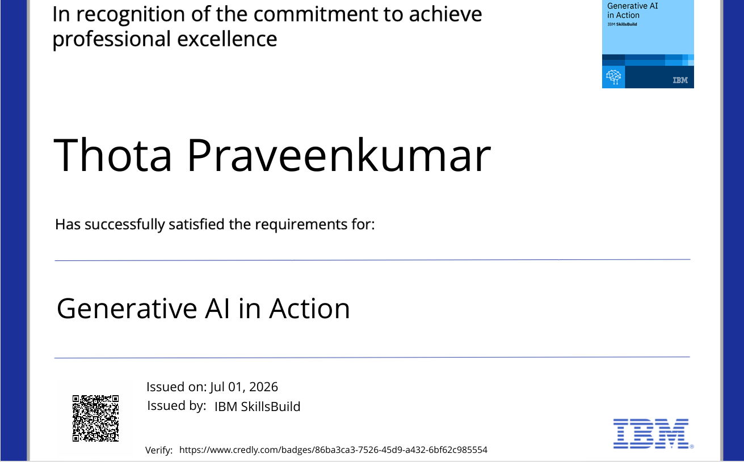
Certificates Earned:1
Generative AI in Action certificate

Slide 17
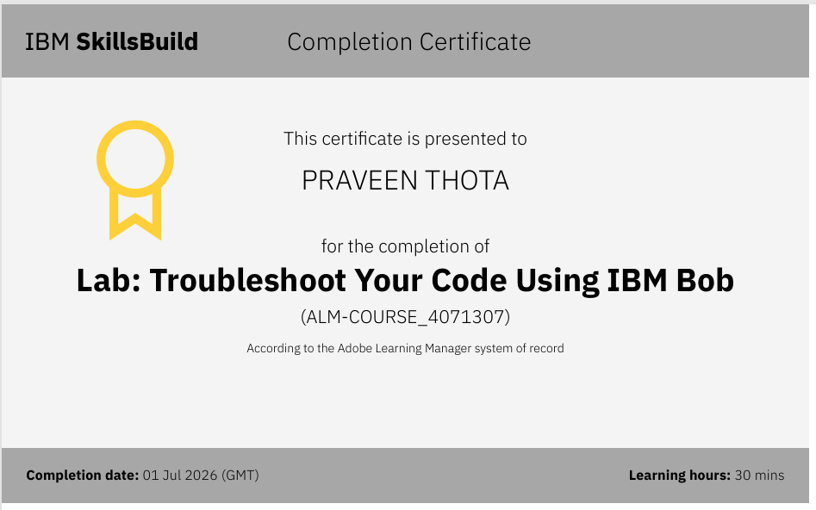
Certificates Earned:​2
Add your IBM BOB Certificate

Slide 18
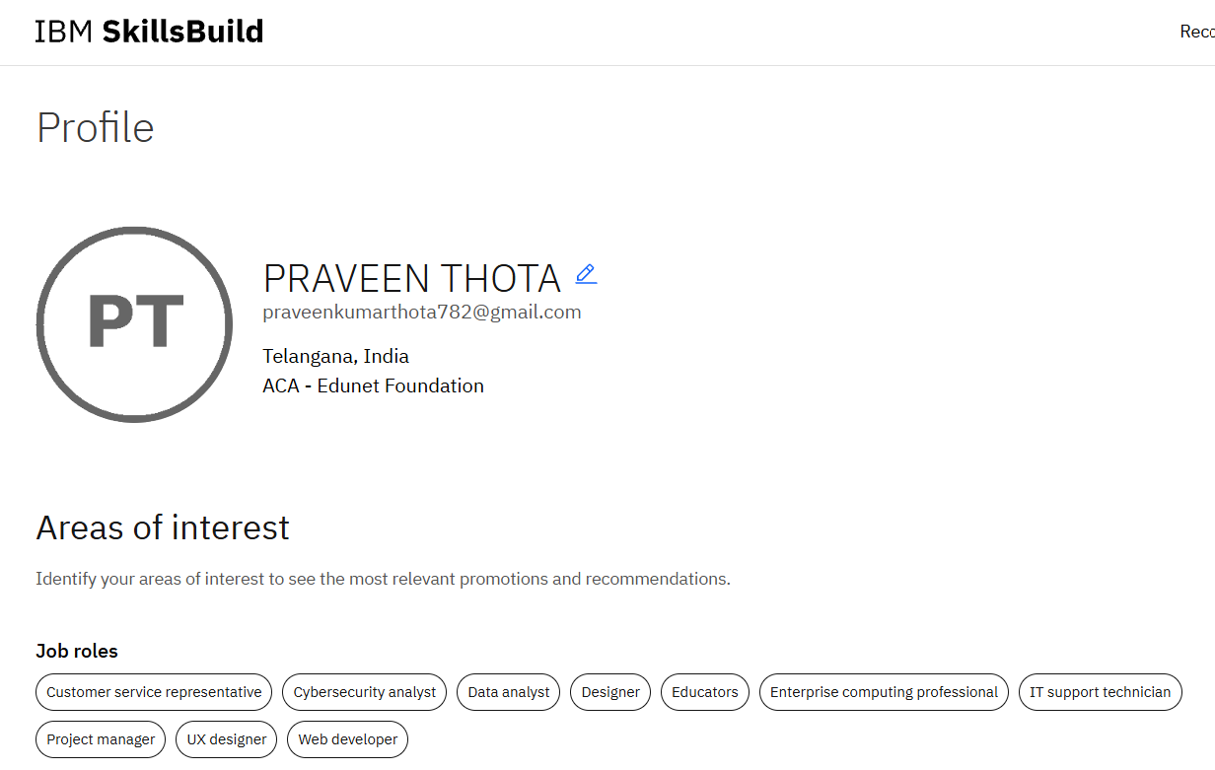
IBM SKILLS BUILD PROFILE

Slide 19


